Slide 1
Introduction: Basics
Nahin Ul Sadad/Utsha Das
CSE, RUET

Slide 2
Computer Science vs Computer Engineering
Computer Science: Computer science is the study of algorithmic processes and computational machines.
Algorithmic Processes = Programming + Algorithms
Computational Machines = Theoretical Computer Science
Computer Engineering:
Computer Engineering is a branch of engineering that integrates several fields of computer science and electronic engineering required to develop computer hardware and software.
Roughly,
Computer Science ≈ Software Courses
Computer Engineering ≈ Hardware Courses
But there are many overlaps in between them.

Slide 3
Figure: Map of CSE
Operating System
Information System Analysis
Machine Learning
Data Mining
Digital Image Processing
Computer Security
Artificial Intelligence
Database
Digital Signal Processing
Software Engineering
Computer
Science
Computer Graphics
Computer Network
Data Structure + Algorithms
Object Oriented Programming (OOP)
Software Engineering
High Level Language Programming (Structured)
Computer
Engineering
Compiler
Assembly Program
Data Communication
Assembler
Peripherals & Interfacing
Machine Program
Computer Architecture
Computer Architecture
Electrical Machines & Instrumentations
Digital Electronics
Parallel and Distributed Processing
VLSI
Analog Electronics
Electrical Engineering

Slide 4
Computer Architecture
In computer engineering, computer architecture is a set of rules and methods that describe the functionality, organization, and implementation of computer systems.
Computer architecture is the combination of microarchitecture and instruction set architecture.
Here, Instruction Set Architecture (ISA) = Functionality
Microarchitecture = Organization + Implementation

Slide 5
Computer Organization (Microarchitecture)
In computer engineering, microarchitecture, also called computer organization and sometimes abbreviated as µarch or uarch, is the way a given instruction set architecture (ISA) is implemented in a particular processor.
A given ISA may be implemented with different microarchitectures. Implementations may vary due to different goals of a given design or due to shifts in technology.

Slide 6
Instruction Set Architecture (ISA)
Instruction Set Architecture (ISA) defines the supported instructions, data types, registers, the hardware support for managing main memory, fundamental features (such as the memory consistency, addressing modes, virtual memory), and the input/output model of computer system.
An ISA specifies the behavior of machine code running on implementations of that ISA in a fashion that does not depend on the characteristics of that implementation, providing binary compatibility between implementations.

Slide 7
Instruction Set Architecture (ISA)
This enables multiple implementations of an ISA that differ in characteristics such as performance, physical size, and monetary cost (among other things), but that are capable of running the same machine code, so that a lower-performance, lower-cost machine can be replaced with a higher-cost, higher-performance machine without having to replace software.
For example, ISA of Intel/AMD CPU called x86 (32 bit) or x86_64 (64 bit) remains same from 8086. But ISA has been extended over the years to add new features/instructions. Example of advanced instructions are: MMX, SSE, SSE2, SSE3, SSSE3, SSE4, SSE4.1, SSE4.2, AVX, AVX2, AVX-512 etc.
Notes:
MMX Introduce eight 64 bit registers (MM0-MM7) and instructions to work with eight signed/unsigned bytes, four signed/unsigned words, two signed/unsigned dwords.
3DNow! Add support for single precision floating point operand to MMX. Few operation supported, for example addition, subtraction, multiplication.
SSE Introduce eight/sixteen 128 bit registers (XMM0-XMM7/15) and instruction to work with four single precision floating point operands. Add integer operations on MMX registers too. (The MMX-integer part of SSE is sometimes called MMXEXT, and was implemented on a few non-Intel CPUs without xmm registers and the floating point part of SSE.)
SSE2 Introduces instruction to work with 2 double precision floating point operands, and with packed byte/word/dword/qword integers in 128-bit xmm registers.
SSE3 Add a few varied instructions (mostly floating point), including a special kind of unaligned load (lddqu) that was better on Pentium 4, synchronization instruction, horizontal add/sub.
SSSE3 Again a varied set of instructions, mostly integer. The first shuffle that takes its control operand from a register instead of hard-coded (pshufb). More horizontal processing, shuffle, packing/unpacking, mul+add on bytes, and some specialized integer add/mul stuff.

Slide 8
Instruction Set Architecture (ISA)
Even though ISA remained same but its implementation (microarchitecture) are different from processor to processor. It also enables the evolution of the microarchitectures of the implementations of that ISA, so that a newer, higher-performance implementation of an ISA can run software that runs on previous generations of implementations.
Microarchitecture usually differs by transistor size/technology node. Newer generation processor uses smaller size transistors than older generation processor. Since silicon area remains fixed, smaller size transistors enable better implementation of existing components inside processor.
For example, 1st generation intel core i5 processor released in 2008 uses 45 nm size transistors whereas 12nd generation intel core i5 processor released in 2021 uses 14 nm size transistors.

Slide 9





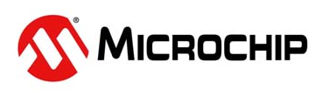

Career Opportunities in Hardware (Semiconductor) Industry

Slide 10






Computer Engineering Jobs

Slide 11
Relationship between Hardware and Software

Slide 12
Question: Can high level language program (Software) be run on computer processor (Hardware) directly?
Ans: Computer understands only program written in 0/1. It is called Machine Code/Program. So, High level language program must be converted to Machine Language Program.

Slide 13
Conversion from High Level Program to Machine Code
int main()
{
int a=10;
a=a+5;
return 0;
}
Compiler
call ___main
mov DWORD PTR [esp+12], 10
add DWORD PTR [esp+12], 5
mov eax, 0
Assembler
c7 44 24 0c 0a 00 00
83 44 24 0c 05
b8 00 00 00 00
High Level Language
Assembly Language
Machine Language

Slide 14
Question: What kind of machine code does computer processor understand?
Ans: Every computer processor has something called Instruction Set Architecture (ISA) which defines machine code for specific instruction.
Compiler/Assembler must generate machine code based on ISA. ISA is the one that connects Hardware and Software together.

Slide 15
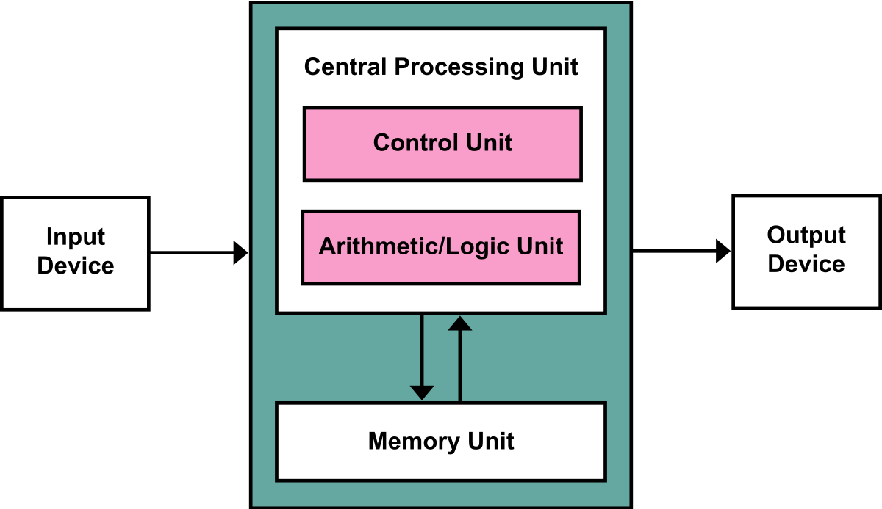
Question: How does computer processor itself run machine code?
Ans: Every modern processor is based on Von Neumann Model.
Central Processing Unit (CPU)
Arithmetic and Logic Unit (ALU)
Control Unit (CU)
Register Set
Main Memory (RAM)
Figure: Von Neumann Model

Slide 16
Question: How does computer processor itself run machine code?
Computer will fetch instruction from Main Memory (RAM).
Instruction will be decoded by control unit and will select registers and/or immediate values.
Data within registers and/or immediate values will be sent to Arithmetic and Logic Unit (ALU) to perform operations.
ALU will perform operation and result will be sent to the register to be written.
Control unit can send data from registers to Main memory.

Slide 17
Question: How are computer building blocks like ALU, CU, Register Set, Main Memory etc. made of?
Ans: They are made of digital electronics building block like AND/OR etc.

Slide 18
Question: How are digital electronics building block like AND/OR etc. made of?
Ans: They are made of analog electronics building block called transistor.

Slide 19
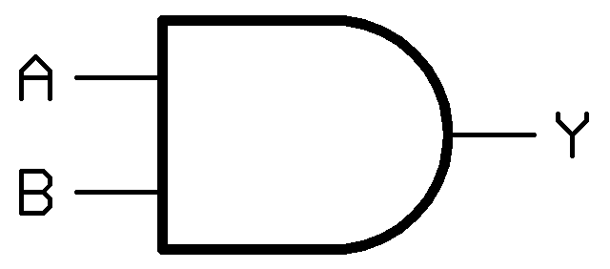
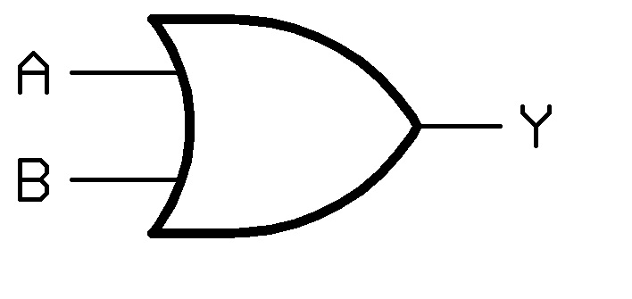
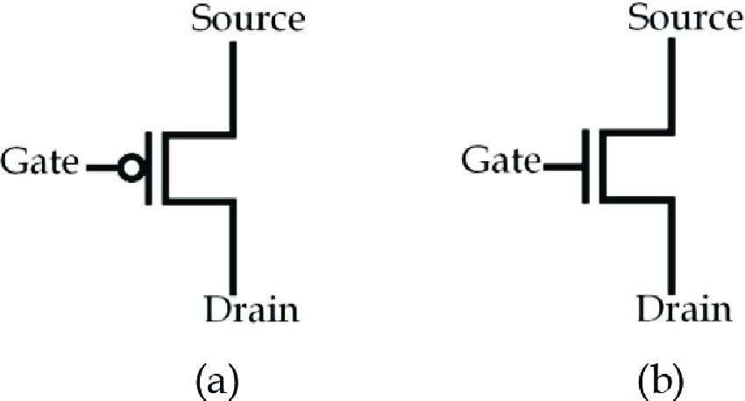
Question: How does a high level language program run on transistor inside of computer processor?
Answer: Connection between High Level Language Program and Transistor
High Level Language Program
int main(){int a=10; a=a+5; return 0;}
Compiler
Software
Assembly Language Program
mov DWORD PTR [rbp-4], 10
add DWORD PTR [rbp-4], 5
Assembler
Machine Language Program
c7 45 fc 0a 00 00 00
83 45 fc 05
c7 is opcode for mov
83 is opcode for add
Instruction Set Architecture
From Intel ISA
Computer Architecture
ALU
CU
Register Set
Main Memory
Hardware
Digital Electronics
Adder
Multiplier
Flip-flop
Analog Electronics
Transistor
(Acts as a switch)
Physics (Law of Nature)

Slide 20
Relationship between Theory of Computation and Computer Architecture

Slide 21
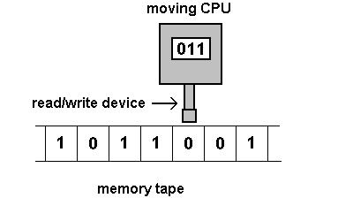
Turing Machine
Turing Machine is the mathematical model of real-life computers.
Figure: Turing Machine
All algorithms developed are based on Turing machine. It means algorithms are not written with particular CPU like Intel, AMD etc. in mind.

Slide 22
Turing Machine
It is not possible to create Turing machine in real-life as mathematical theory considers infinite memory which is not possible.
Turing machines are mathematically equivalent to each other. Modern CPUs like Intel, AMD, ARM are Turing complete which means they are mathematically equivalent to each other. It also means they are capable of running same algorithms.

Slide 23
Turing Machine
It is mathematically proved that there is no mathematical/theoretical machine that is more computationally powerful (not considering efficiency of computation) than Turing machine.
It means it is possible to speed up real-life CPU but we can not create a CPU which can compute something that Turing machine cannot.
For example, Turing machine cannot solve “Halting problem”. It also means real-life CPU cannot solve “Halting problem” no matter how powerful CPU you use.
Notes:
Given a program written in some programming language(c/c++/java) will it ever get into an infinite loop(loop never stops) or will it always terminate(halt)? This is an undecidable problem because we cannot have an algorithm which will tell us whether a given program will halt or not in a generalized way i.e by having specific program/algorithm.

Slide 24
Analog Electronics I

Slide 25
Analog Electronics
Analog Electronics deal with two components:
Diode: A diode is a two-terminal electronic component that conducts current primarily in one direction.
Transistor: A transistor is a semiconductor device used to amplify or switch electronic signals and electrical power. There are usually two types of transistors. They are: Bipolar Junction Transistor and Field Effect Transistor.
Analog Electronics
Diode
Transistor (BJT & FET)
Switch
Amplifier
Applications
AC to DC Conversion
Computer
Communication

Slide 26
Analog Electronics (Transistor)
Role of transistor:
Switch: Transistors can act as a switch. They are combined to create digital logic gates like AND, OR, XOR etc.
Amplifier: Transistor is used to amplify signal applied to its input.
Importance of Transistor:
Transistor is the real building block of processor. For example, Intel 8-core 4th Generation Core i7 processor has 2.6 Billions transistors!
MOSFETs (Metal Oxide Semiconductor Field Effect Transistor) (A type of FET transistors) are used to build modern processor using CMOS technology.

Slide 27
Question: What is the role of transistor? Answer: Transistor works as 1. Switch and 2. Amplifier

Slide 28
Question: Explain the role of transistor in computer processor. Answer: Transistor works as switch inside computer processor.

Slide 29
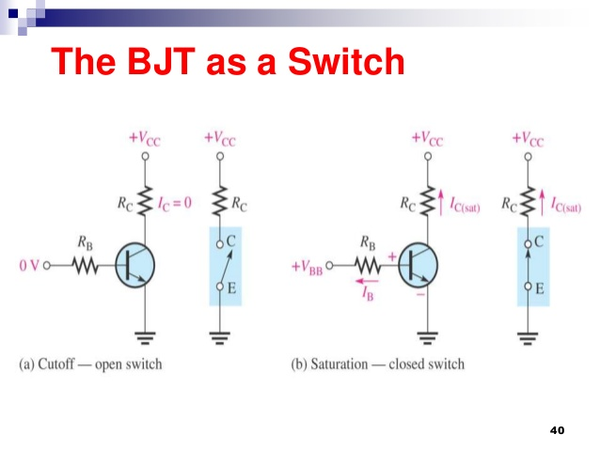
Question: How does BJT transistor work as switch? Answer:

Slide 30
Question: How does BJT transistor work as switch? Answer:
Volt | ON / OFF
0 V | OFF
5 V | ON
0 V
5 V
Circuit is OFF
Circuit is ON

Slide 31
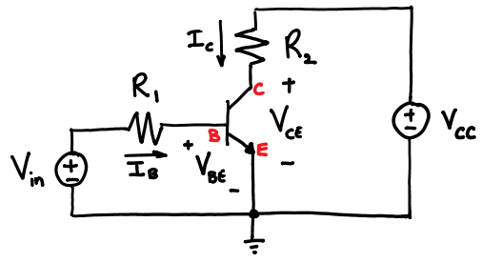
Transistor Circuit Diagram

Slide 32
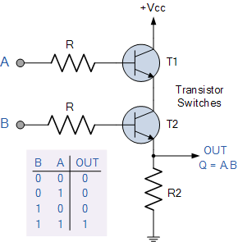
2-input Transistor AND Gate
Link: https://www.electronics-tutorials.ws/logic/logic_2.html

Slide 33
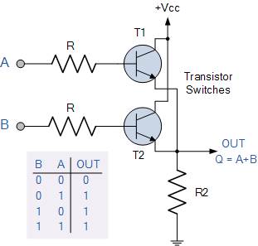
2-input Transistor OR Gate
Link: https://www.electronics-tutorials.ws/logic/logic_3.html

Slide 34
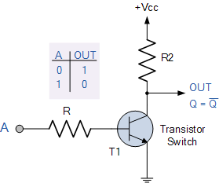
1-input Transistor NOT Gate (Inverter)
Link: https://www.electronics-tutorials.ws/logic/logic_4.html

Slide 35

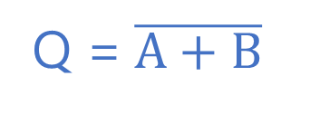
Ans: 2-input NOR Gate

Slide 36
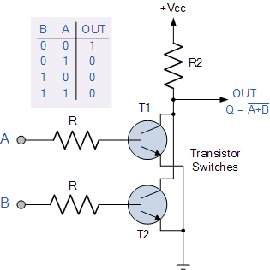
Ans: Equivalent 2-input NOR Gate
Link: https://www.electronics-tutorials.ws/logic/logic_6.html

Slide 37
Question: What type of transistor is used in real life modern processor? Answer: CMOS = Complementary Metal–Oxide–Semiconductor Field Effect Transistor

Slide 38
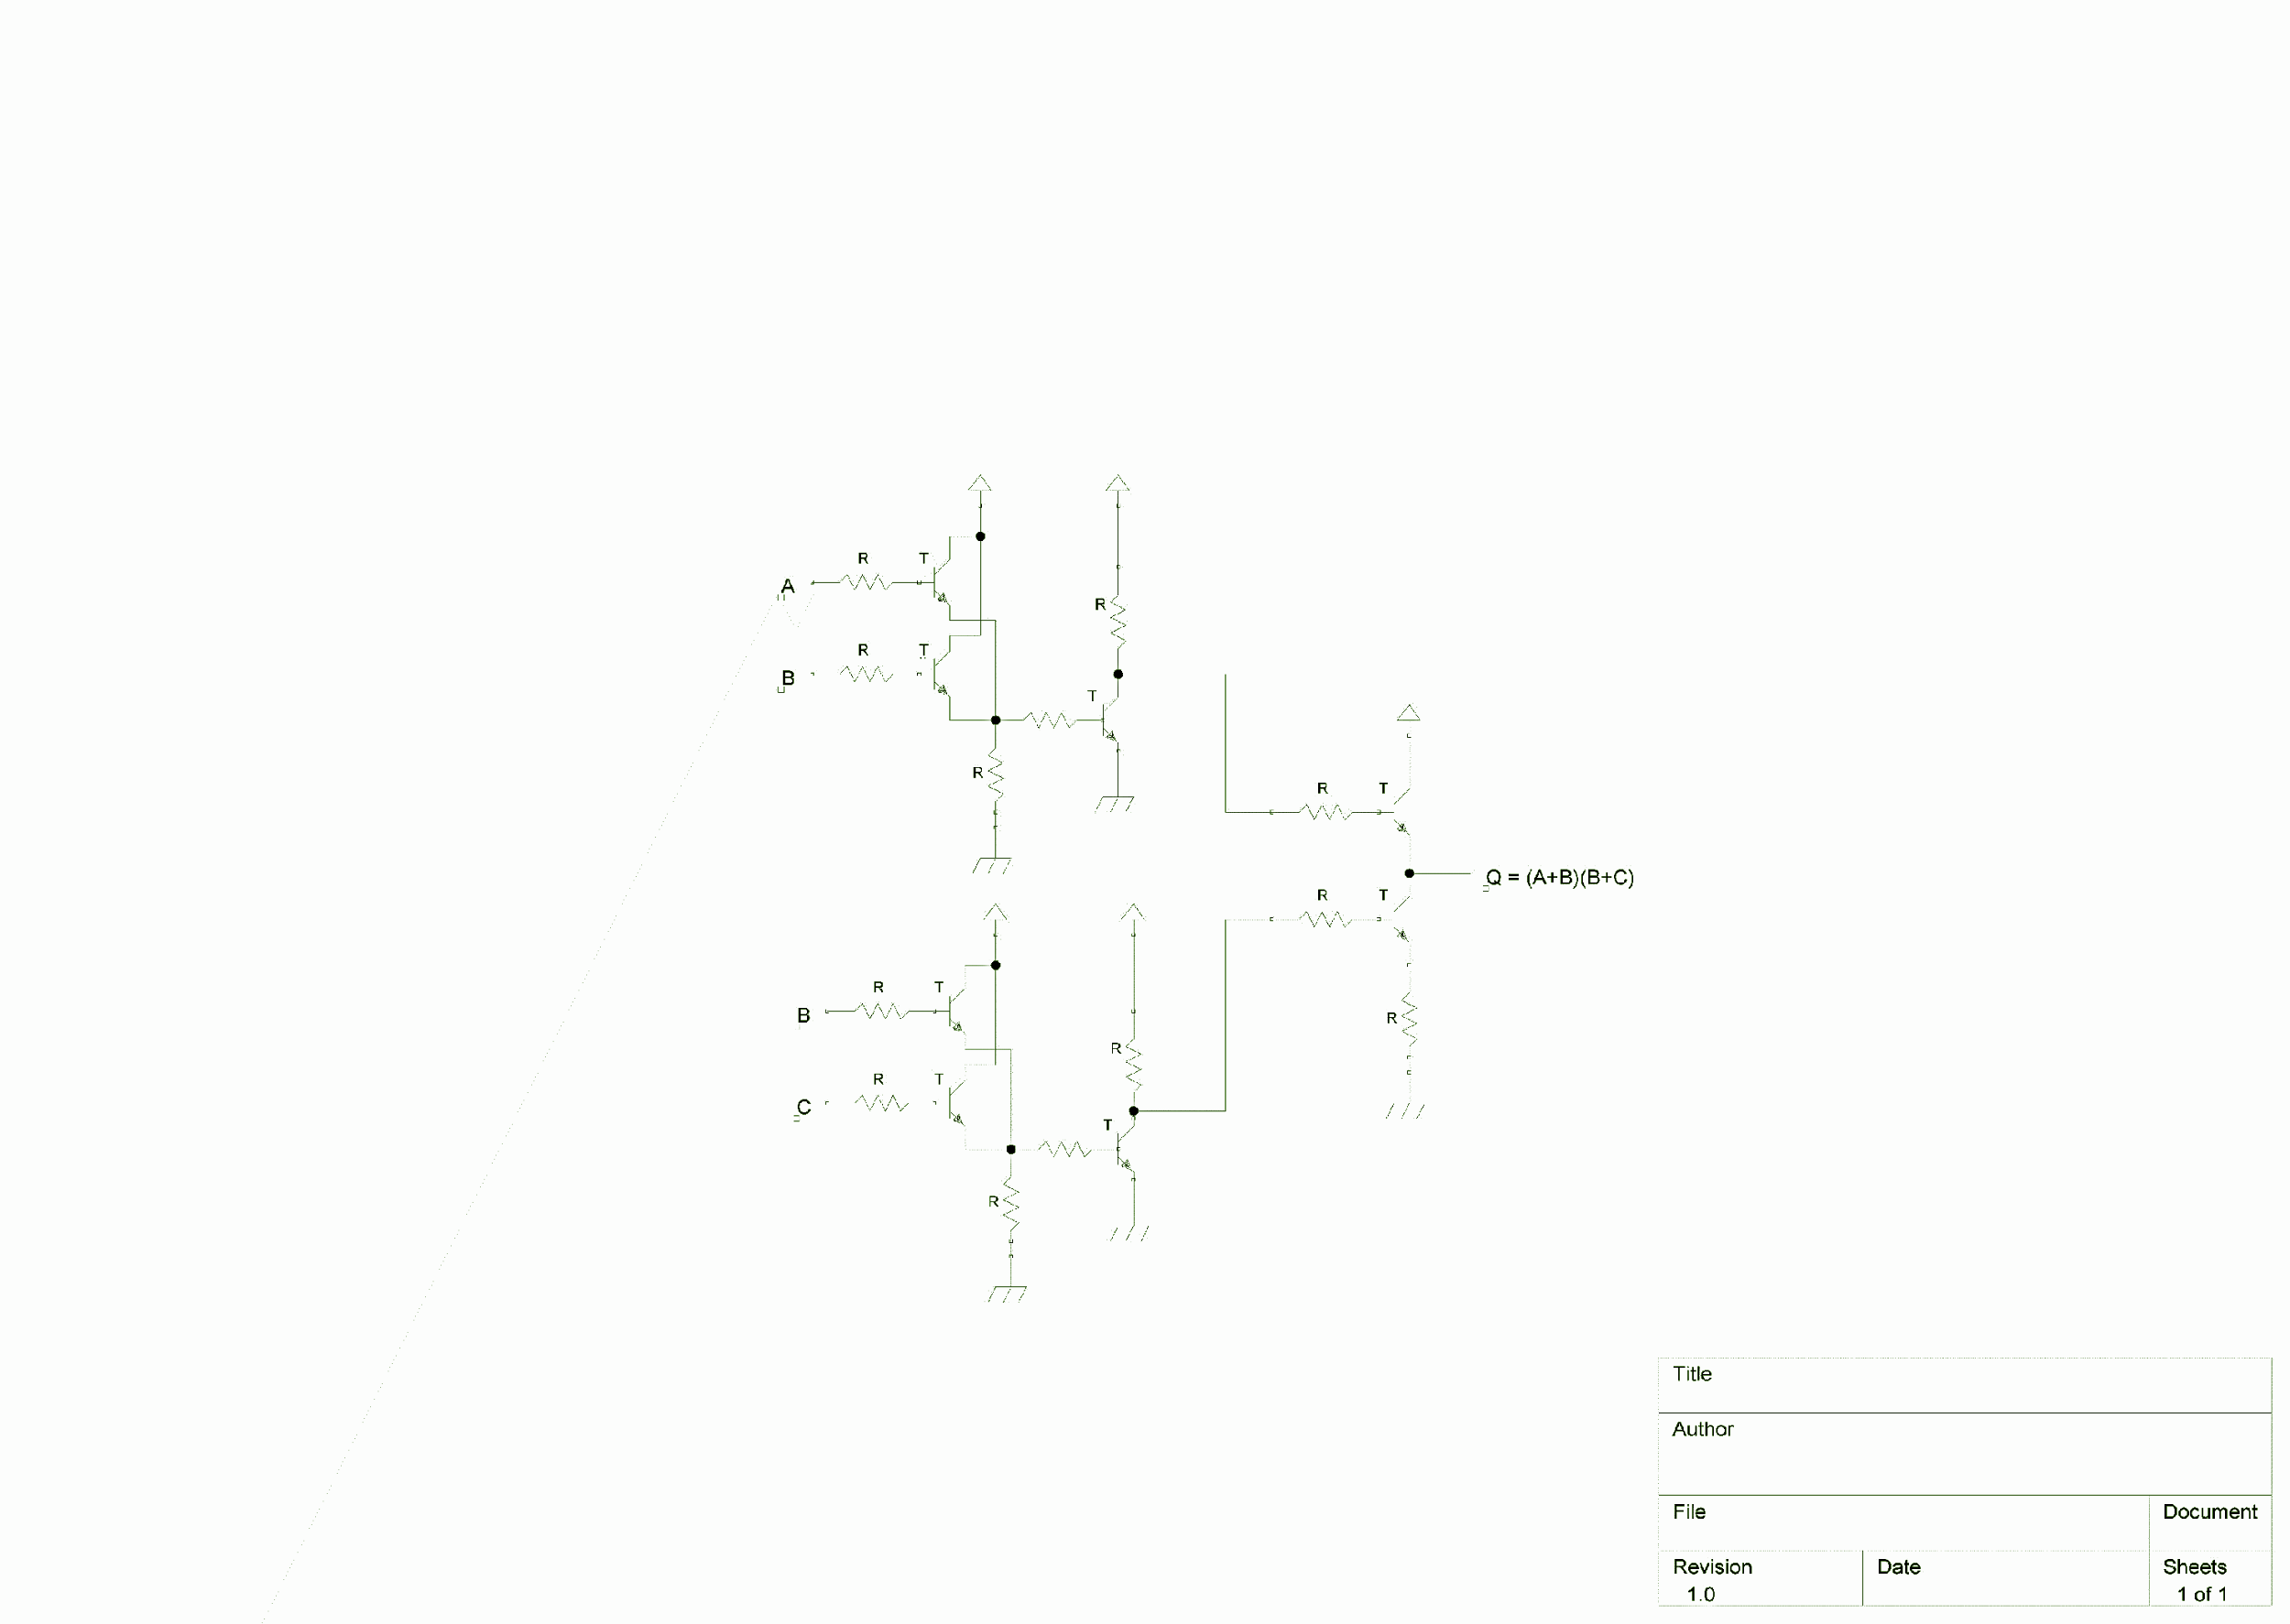
Example: BJT
Answer:

Slide 39
Exercises

Slide 40
Thank You ☺

